Slide 1
Hagemeyer Family History Photo Album
Compiled by
Stanley Hagemeyer
Copyright 2019

Slide 2
This album begins with
Siebe and Bauwina Hagemeyer
and shows branches into
the generations before them and
those who came after.

Slide 3
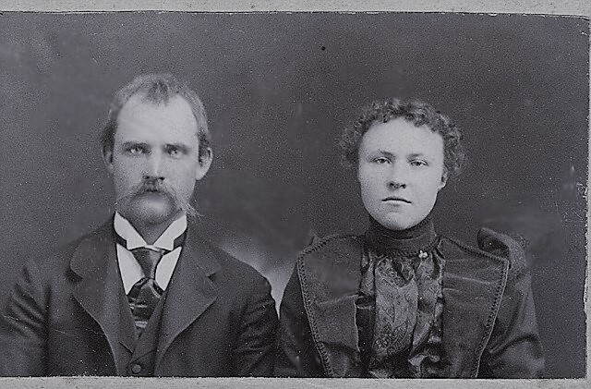
Siebe and Bauwina (Sonius) Hagemeyer
Wedding photo – May 14, 1900

Slide 4
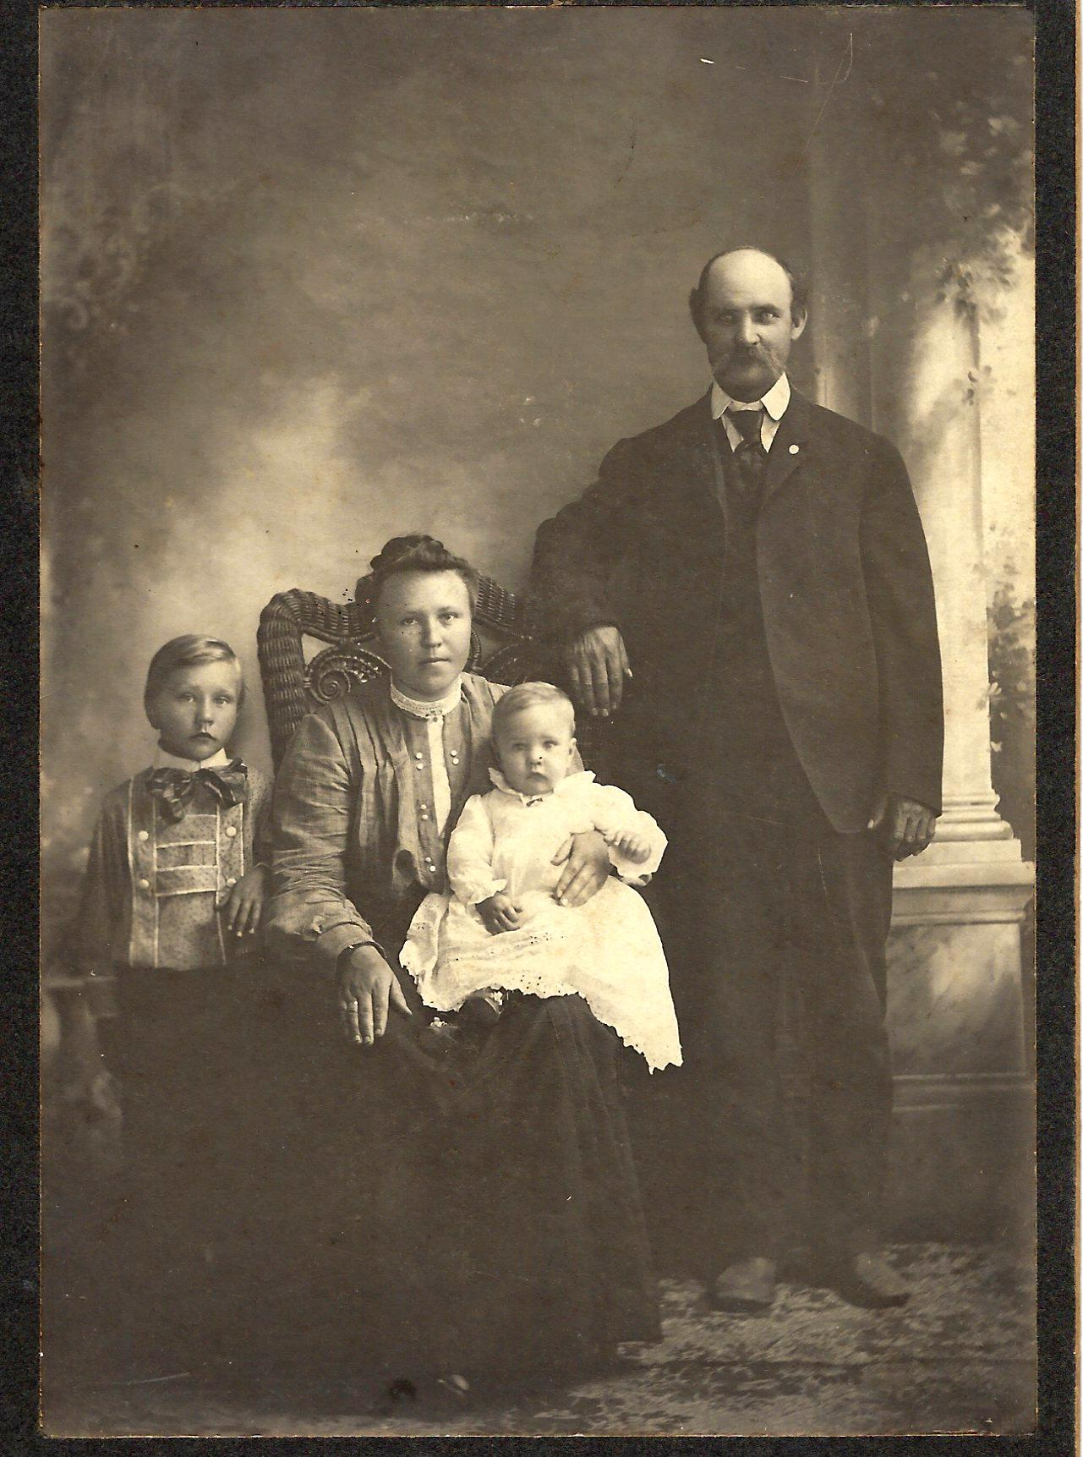
Siebe and Bauwina
Hagemeyer
(~1907)
with Carl (Koert)
Age 5 yrs.
and
Henry (Hank)
age 1 yr.

Slide 5
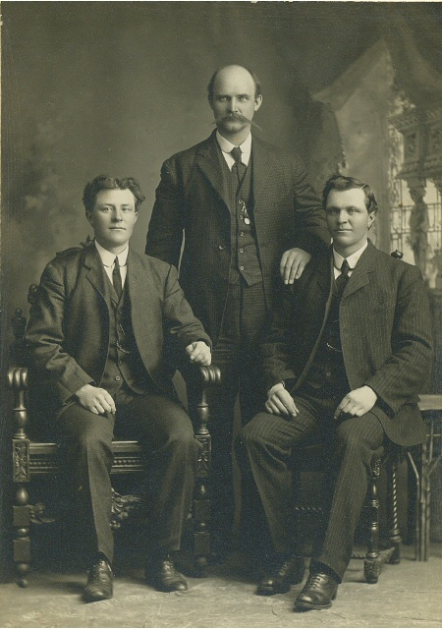
Siebe Hagemeyer (~ 32 yrs. old)
and
brothers-in-law John < and Riemer >
Sonius.
Approximately 1907

Slide 6
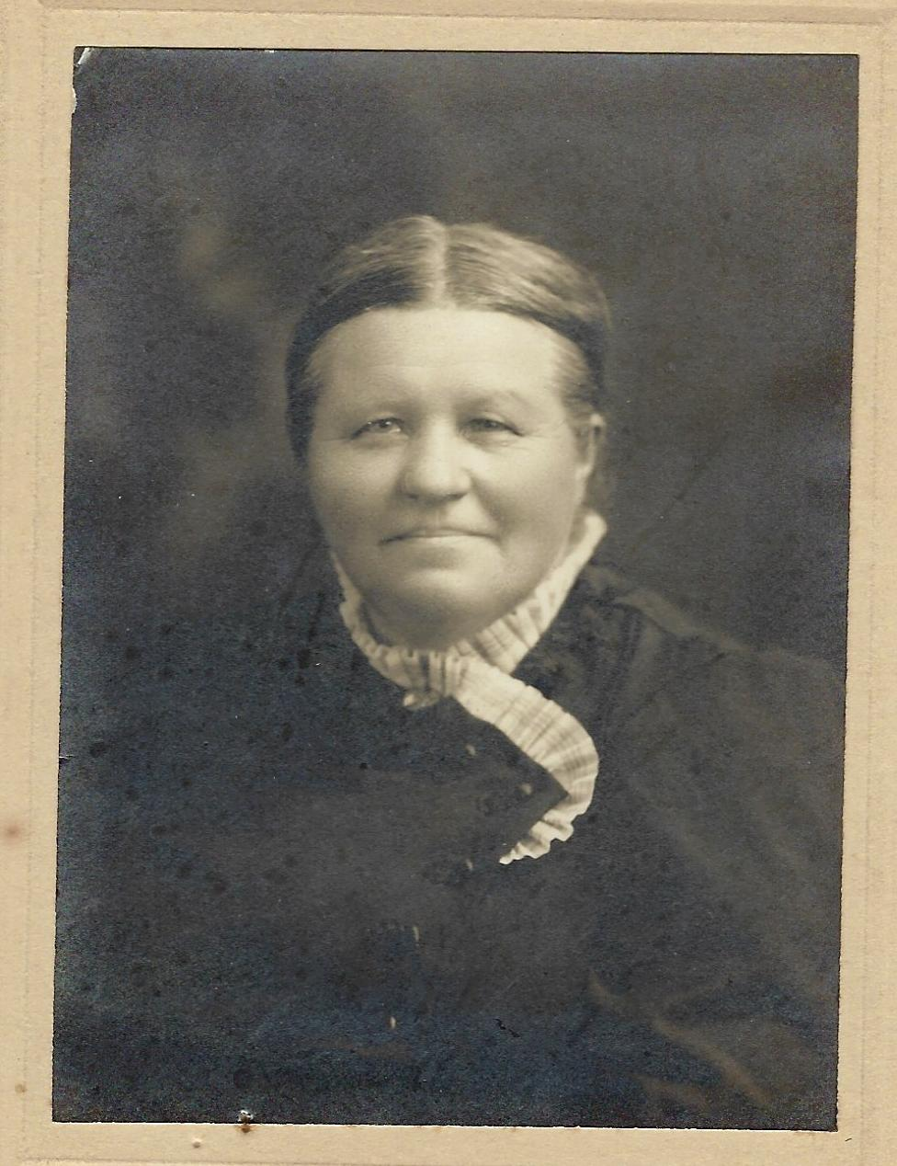
Rixte (Bertie)
Sonius
Bauwina’s mother.

